Slide 1
E3 DRIF
Hardware modifications
4th August 2020
Chris Miles
Senior Staff Engineer
REE／IIBU／SDD／SPD2
Renesas Electronics Corporation

Slide 2
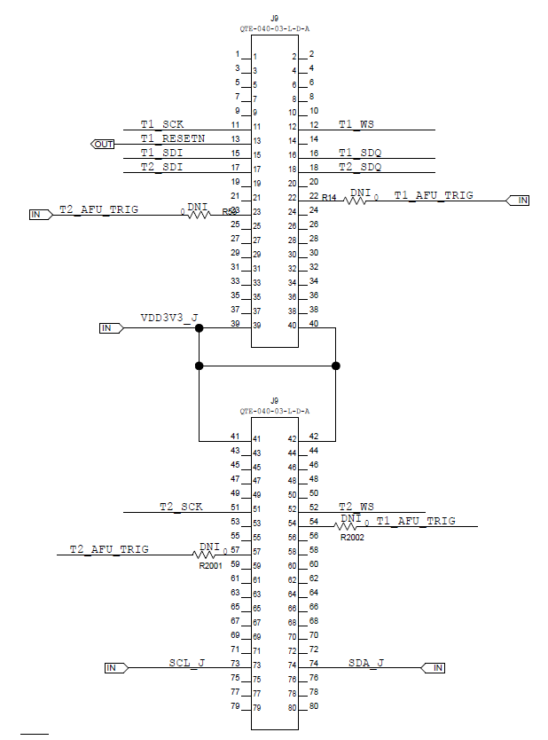
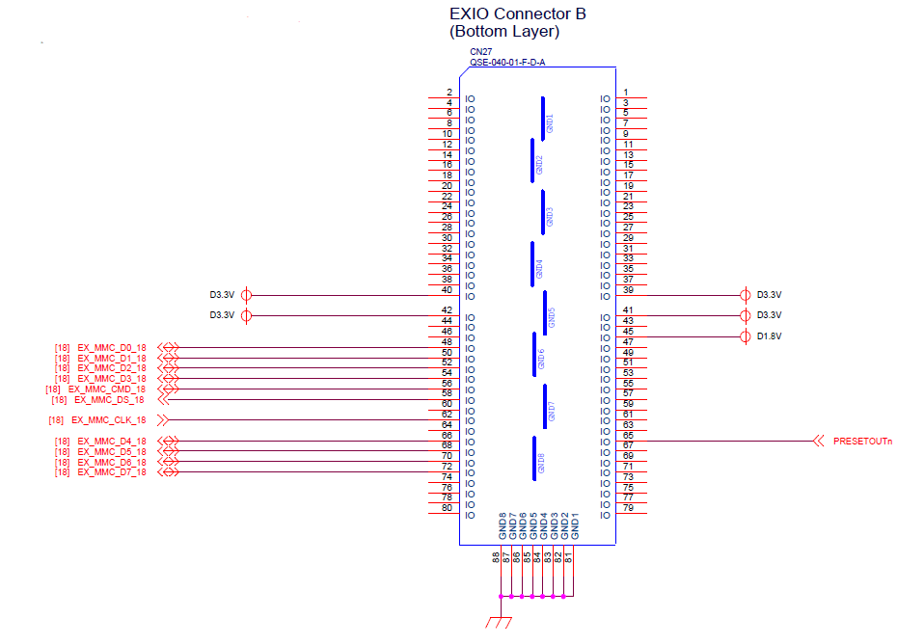
E3 and DRIF CONNECTORS
Additional wire connections are needed on the E3 board to connect DRIF signals
E3 Board (CN27):
R-CarE3 System Evaluation Board "EBISU"
DRIF Board (J9):
Maxim Integrated MAX2175 J5 Demo board Rev C

Slide 3
DRIF Control Signals
DRIF Control | E3 Ball | GPIO | Schematic signal name | Wired | CN27 Pin | DRIF J9 signal name
SCL | H2 | n/a | I2C3_SCL | << >> | 73 | SCL_J
SDA | H3 | n/a | I2C3_SDA | << >> | 74 | SDA_J
RESET# | AD3 | n/a | PRESETOUTn | << >> | 13 | T1_RESETN
Notes:
I2C3 is also used on the E3 board for Ethernet AVB PHY Connector1; Audio CODEC; Board-to-Board Connector 1

Slide 4
DRIF Channel 0 and 1
DRIF 0 pins | E3 Ball | GPIO | Schematic signal name | Wired | CN27 Pin | DRIF J9 signal name
CLK_B | M21 | GP3_12 | SD0_CD | << >> | 11 | T1_SCK
D0_B | M22 | GP3_13 | SD0_WP | << >> | 15 | T1_SDI
D1_B | L22 | GP3_14 | GP3_14/SD1_CD | << >> | 16 | T1_SDQ
SYNC_B | L21 | GP3_15 | GP3_15/SD1_WP | << >> | 12 | T1_WS
DRIF 1 pins | E3 Ball | GPIO | Schematic signal name | Wired | CN27 Pin | DRIF J9 signal name
CLK | P22 | GP5_04 | AUDIO_CLKOUT1 | << >> | 51 | T2_SCK
D0 | P24 | GP5_02 | GP5_02/MAX3355_STAT2 | << >> | 17 | T2_SDI
D1 | P23 | GP5_03 | AUDIO_CLKOUT | << >> | 18 | T2_SDQ
SYNC | P25 | GP5_01 | GP5_01/MAX3355_STAT1 | << >> | 52 | T2_WS
Notes:
R443 is removed to prevent interference with PMIC control
R606 and R605 are removed to prevent interference from USB (CH0) status
SD (CH0) cannot be used.
SD (CH1) cannot be used
Audio clock inputs cannot be used

Slide 5
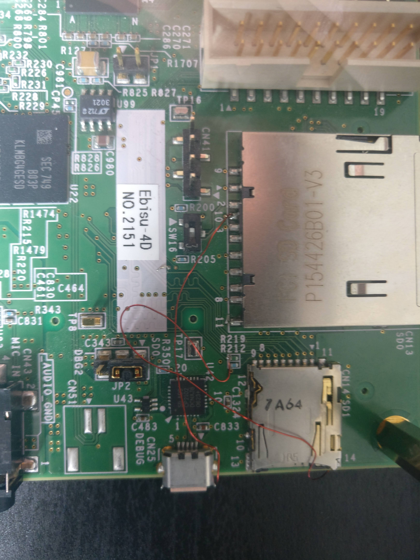
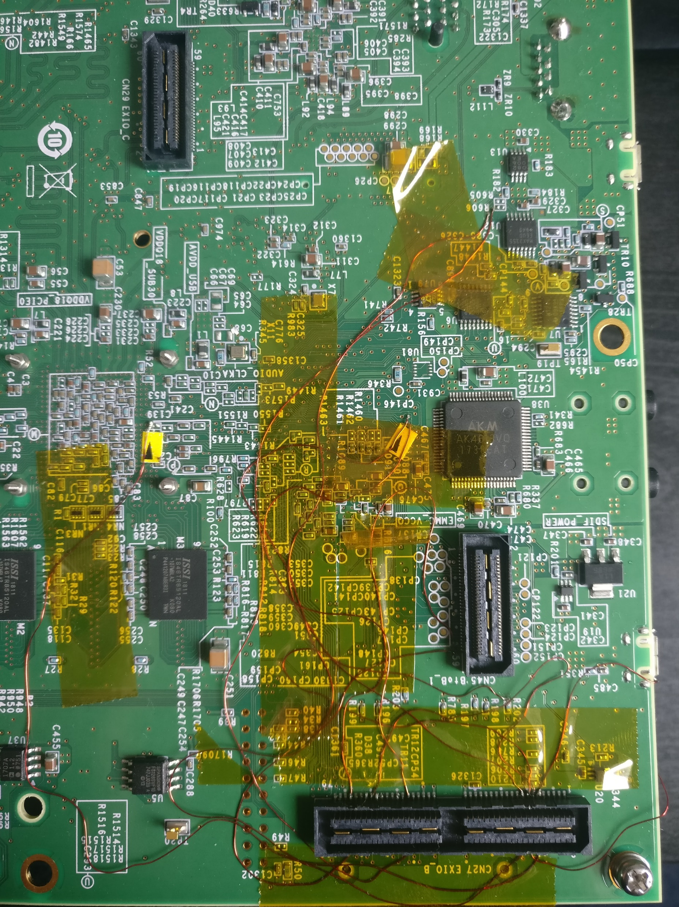
DRIF Channel 0 and 1

Slide 6
DRIF Channel 2 and 3
DRIF 2 pins | E3 Ball | GPIO | Schematic signal name | Wired | CN27 Pin | DRIF J9 signal name
CLK_B | V5 | GP1_04 | A4/DU_DG4/MD25 | << >> | 11 | T1_SCK
D0_B | V2 | GP1_06 | GP1_06/A6 | << >> | 15 | T1_SDI
D1_B | V3 | GP1_07 | GP1_07/A7/MD21 | << >> | 16 | T1_SDQ
SYNC_B | V4 | GP1_05 | GP1_05/A5/MD23 | << >> | 12 | T1_WS
DRIF 3 pins | E3 Ball | GPIO | Schematic signal name | Wired | CN27 Pin | DRIF J9 signal name
CLK_B | AB2 | GP0_08 | D8/DU_DR7/MD12 | << >> | 51 | T2_SCK
D0_B | AC1 | GP0_10 | D10/DU_DG1 | << >> | 17 | T2_SDI
D1_B | AA5 | GP0_11 | D11/DU_DG2/MD7 | << >> | 18 | T2_SDQ
SYNC_B | AB1 | GP0_09 | D9/DU_DG0/MD6 | << >> | 52 | T2_WS
Notes:
E3 pins have dual purpose and are used as Mode during reset
Without DRIF board modifications, the DRIF signals drive the mode pins during reset causing the E3 not to start correctly

Slide 7
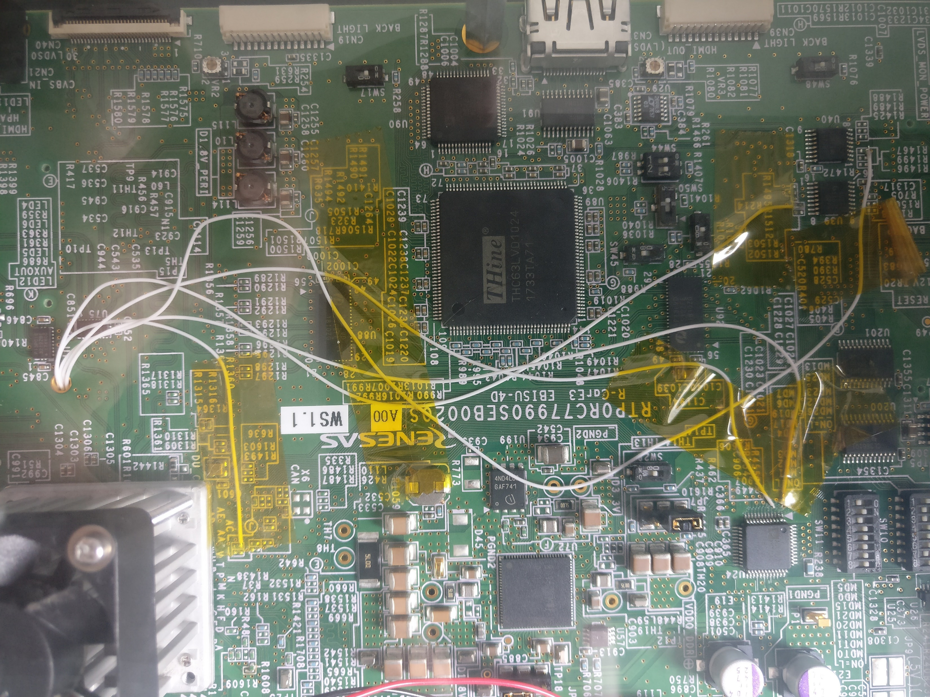
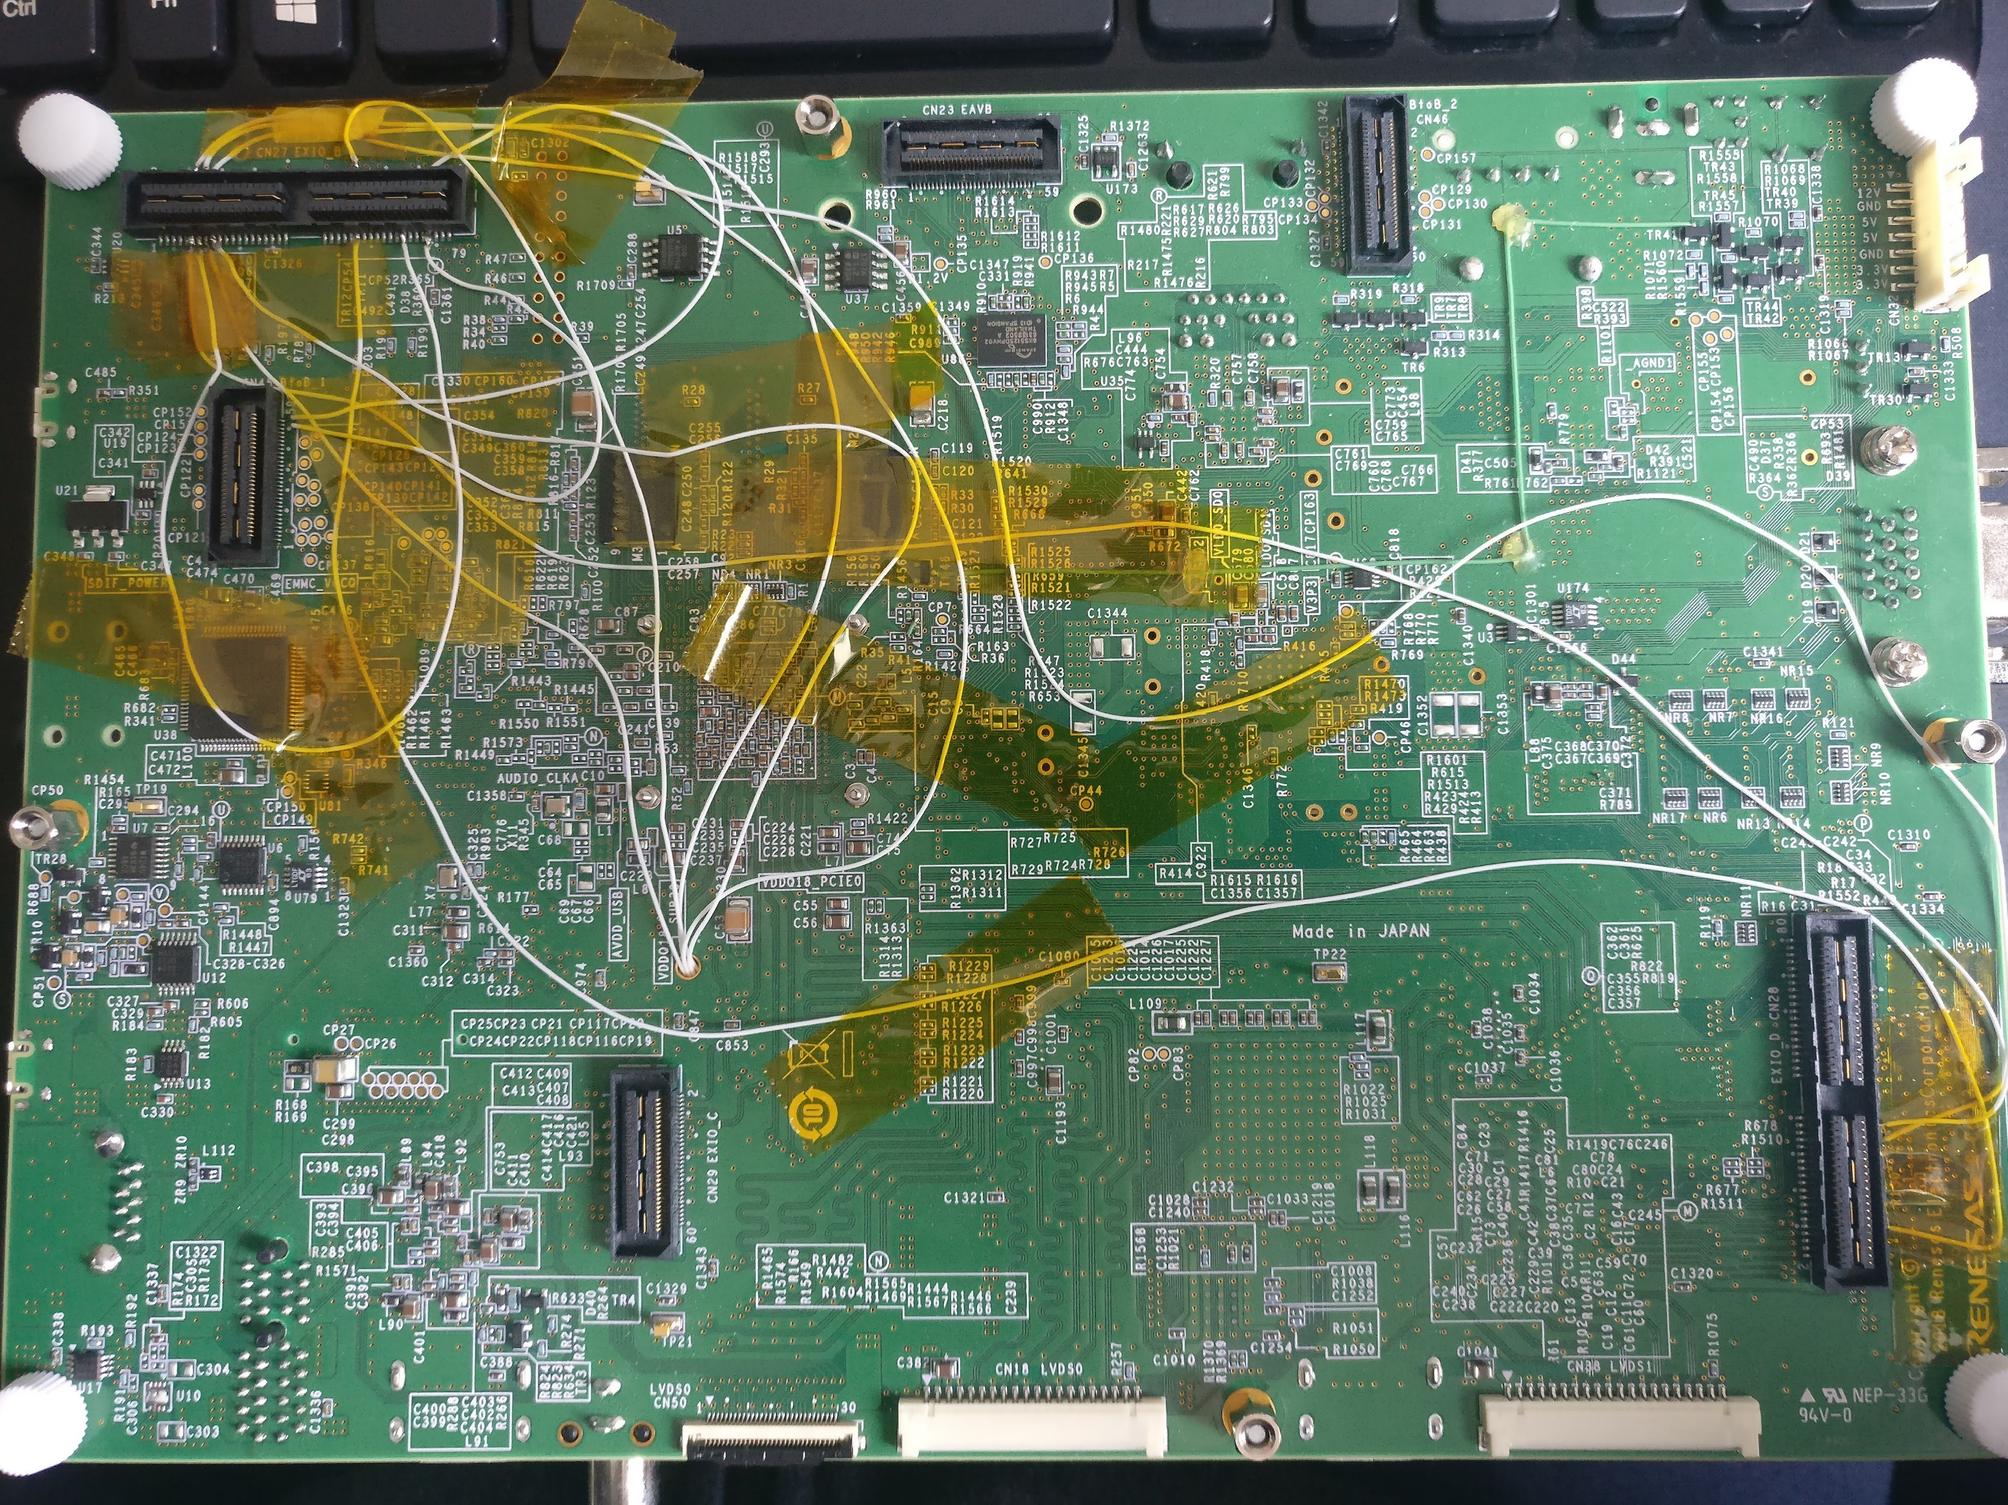
DRIF Channel 2 and 3

Slide 8
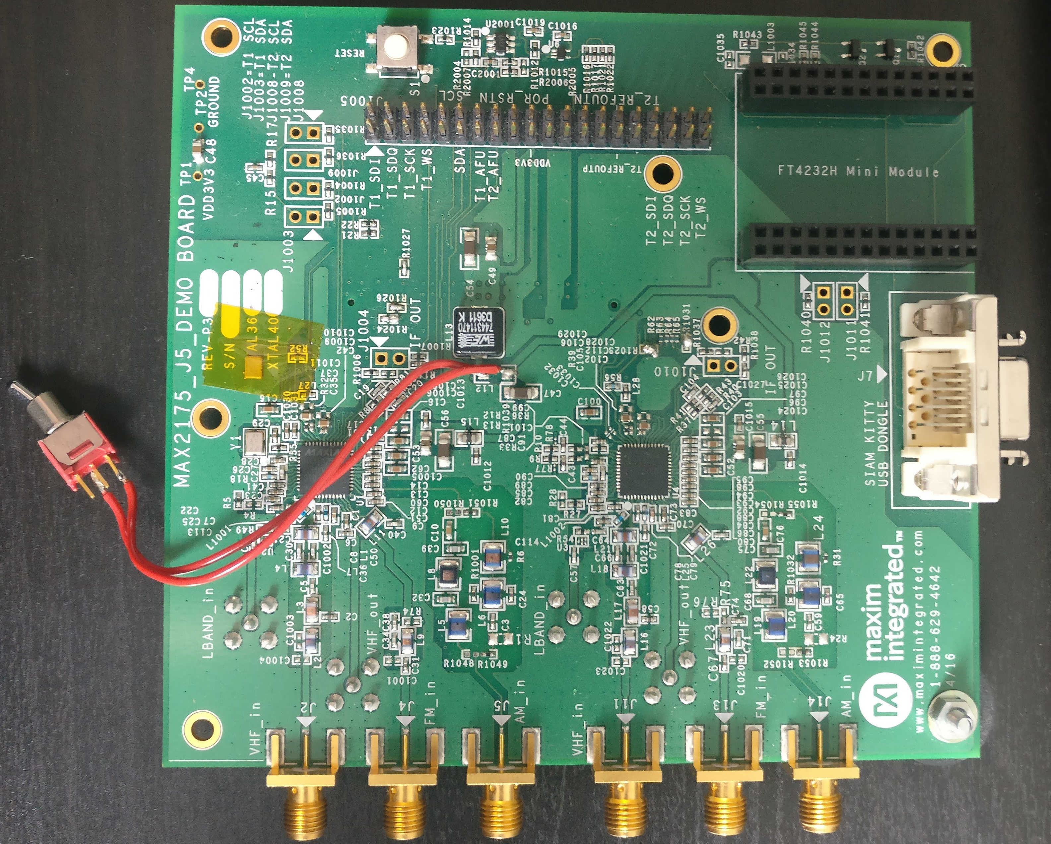
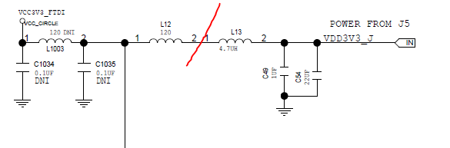
DRIF Board Modification for DRIF Channels 2 and 3
Driving the DRIF board RESET does not tristate the signals causing Mode related issues to the E3
The solution was to modify the DRIF board so that power to the DRIF circuitry could be delayed until after the E3 power up and reset
Lifted one end of L13 and inserted an in-line switch to isolate power form the DRIF board
Once the E3 has powered up and out of reset the switch can be closed.

Slide 9
Renesas.com

